Slide 1

Java With IntelliJ
Conditional
Statement Part 1
If Else Statement

Slide 2


What Makes Something Conditional In Java
You want to have something happen as a result of what you did
Example: A trivia question

Slide 3
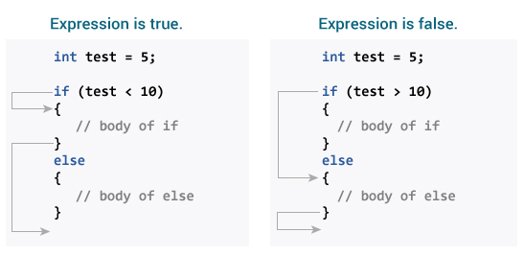
How To Implement A Conditional Statement
In this video we will be using the if else statement
How to use an if else statement?
If([conditions such as: x ==2]){}
Different comparisons
==
<=
>=
>
<
!
[string variable].equals([whatever text])
Else{}

